Slide 1
An Expert System to Identify the Types of Ovarian Cancer
Submitted by
Nishat Soultana Chy
ID-17701021
Department of CSE, University of Chittagong

Slide 2
Contents
Introduction
Aims and Goals
Architecture
Design
Design (Decision Table)
Design(Decision Tree)
Results
Conclusion

Slide 3
Introduction
Ovarian cancer is the deadliest of gynecologic cancers.
Mortality rates are slightly higher for African American women than for Caucasian women. The American Cancer Society estimates that in 2020, about 21,750 new cases of ovarian cancer will be diagnosed and 13,940 women will die of ovarian cancer in the United States. Mortality rates for ovarian cancer have declined only slightly in the forty years since the “War on Cancer” was declared. However, other cancers have shown a much greater reduction in mortality, due to many factors.
The Surveillance, Epidemiology and End Results (SEER) Program reports that in 2016 in the United States approximately 229,875 women were alive who had been diagnosed with ovarian cancer (including those who had been cured of the disease). Ovarian cancer accounts for 2.5 percent of cancers in women. While the 11th most common cancer among women, ovarian cancer is the fifth leading cause of cancer_x0002_related death among women.
An expert system build in prolog can identify the type of cancer. It will help a medical system as well as a doctor to identify the type of ovarian cancer and prescribe as per symptoms.

Slide 4
Aim and Objectives:
To identify the type of Ovarian Cancer.
Sharing knowledge with mass people.
Creating awareness about Ovarian Cancer
Prescribe treatment and medicine according to the type of cancer.

Slide 5
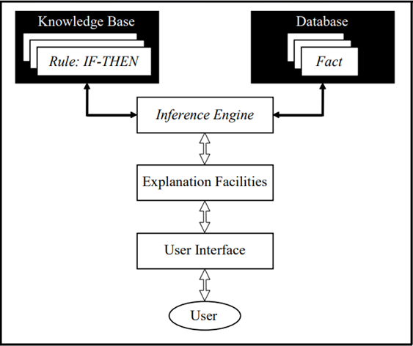
Architecture
The system is based on “Rule Based Architecture”. It percepts input from the environment i.e. interacts with the user through a user interface. Then it tries to resolute the value of the query or the input. It takes facts from the database, uses rules defined into the knowledge base and infer an answer. Then it shows the answer to the user.
Figure: Architecture of the System

Slide 6
Design
Design describe how the expert system react according to commands given to prolog environment for identifying the types of Ovarian Cancer. Action performed by the commands is represented in circular form and arrows represent direction from one action to another action. When all conditions are satisfied according to characteristics then it shows the type of Ovarian Cancer as well as prescribe treatment according to the types. Design of the expert system is shown in Figure-1. Table -1 describes the stages of Ovarian Cancer during the surgery.

Slide 7
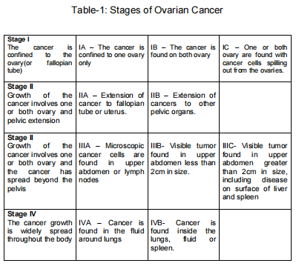
Design( Decision Table)

Slide 8
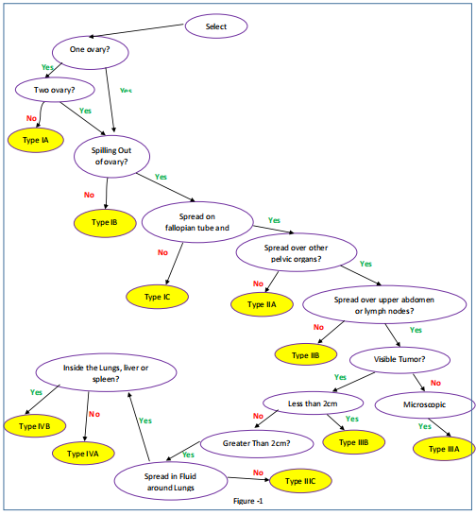
Design( Decision Tree)

Slide 9
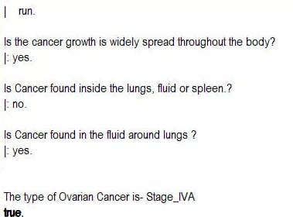
Results
When the user initializes the system, the system ask a question and based on the answer the system moves to the next question and thus finally reaches to the dicision.

Slide 10
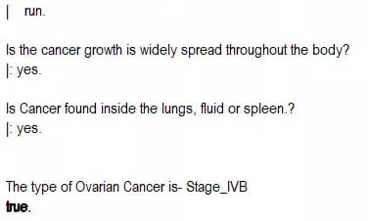
Results

Slide 11
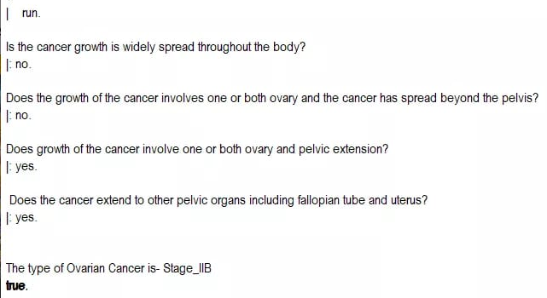
Results

Slide 12
Conclusion
Prolog is best suited for developing this kind of expert system. It can be able to detect the class of animals by using different facts and rules.
It can be able to mimic the human thought. If doctors can identify the stage of cancer properly, the can start the proper treatment early and save a lot of women’s life.

Slide 13
Thank You.
Questions Please?

